Slide 1

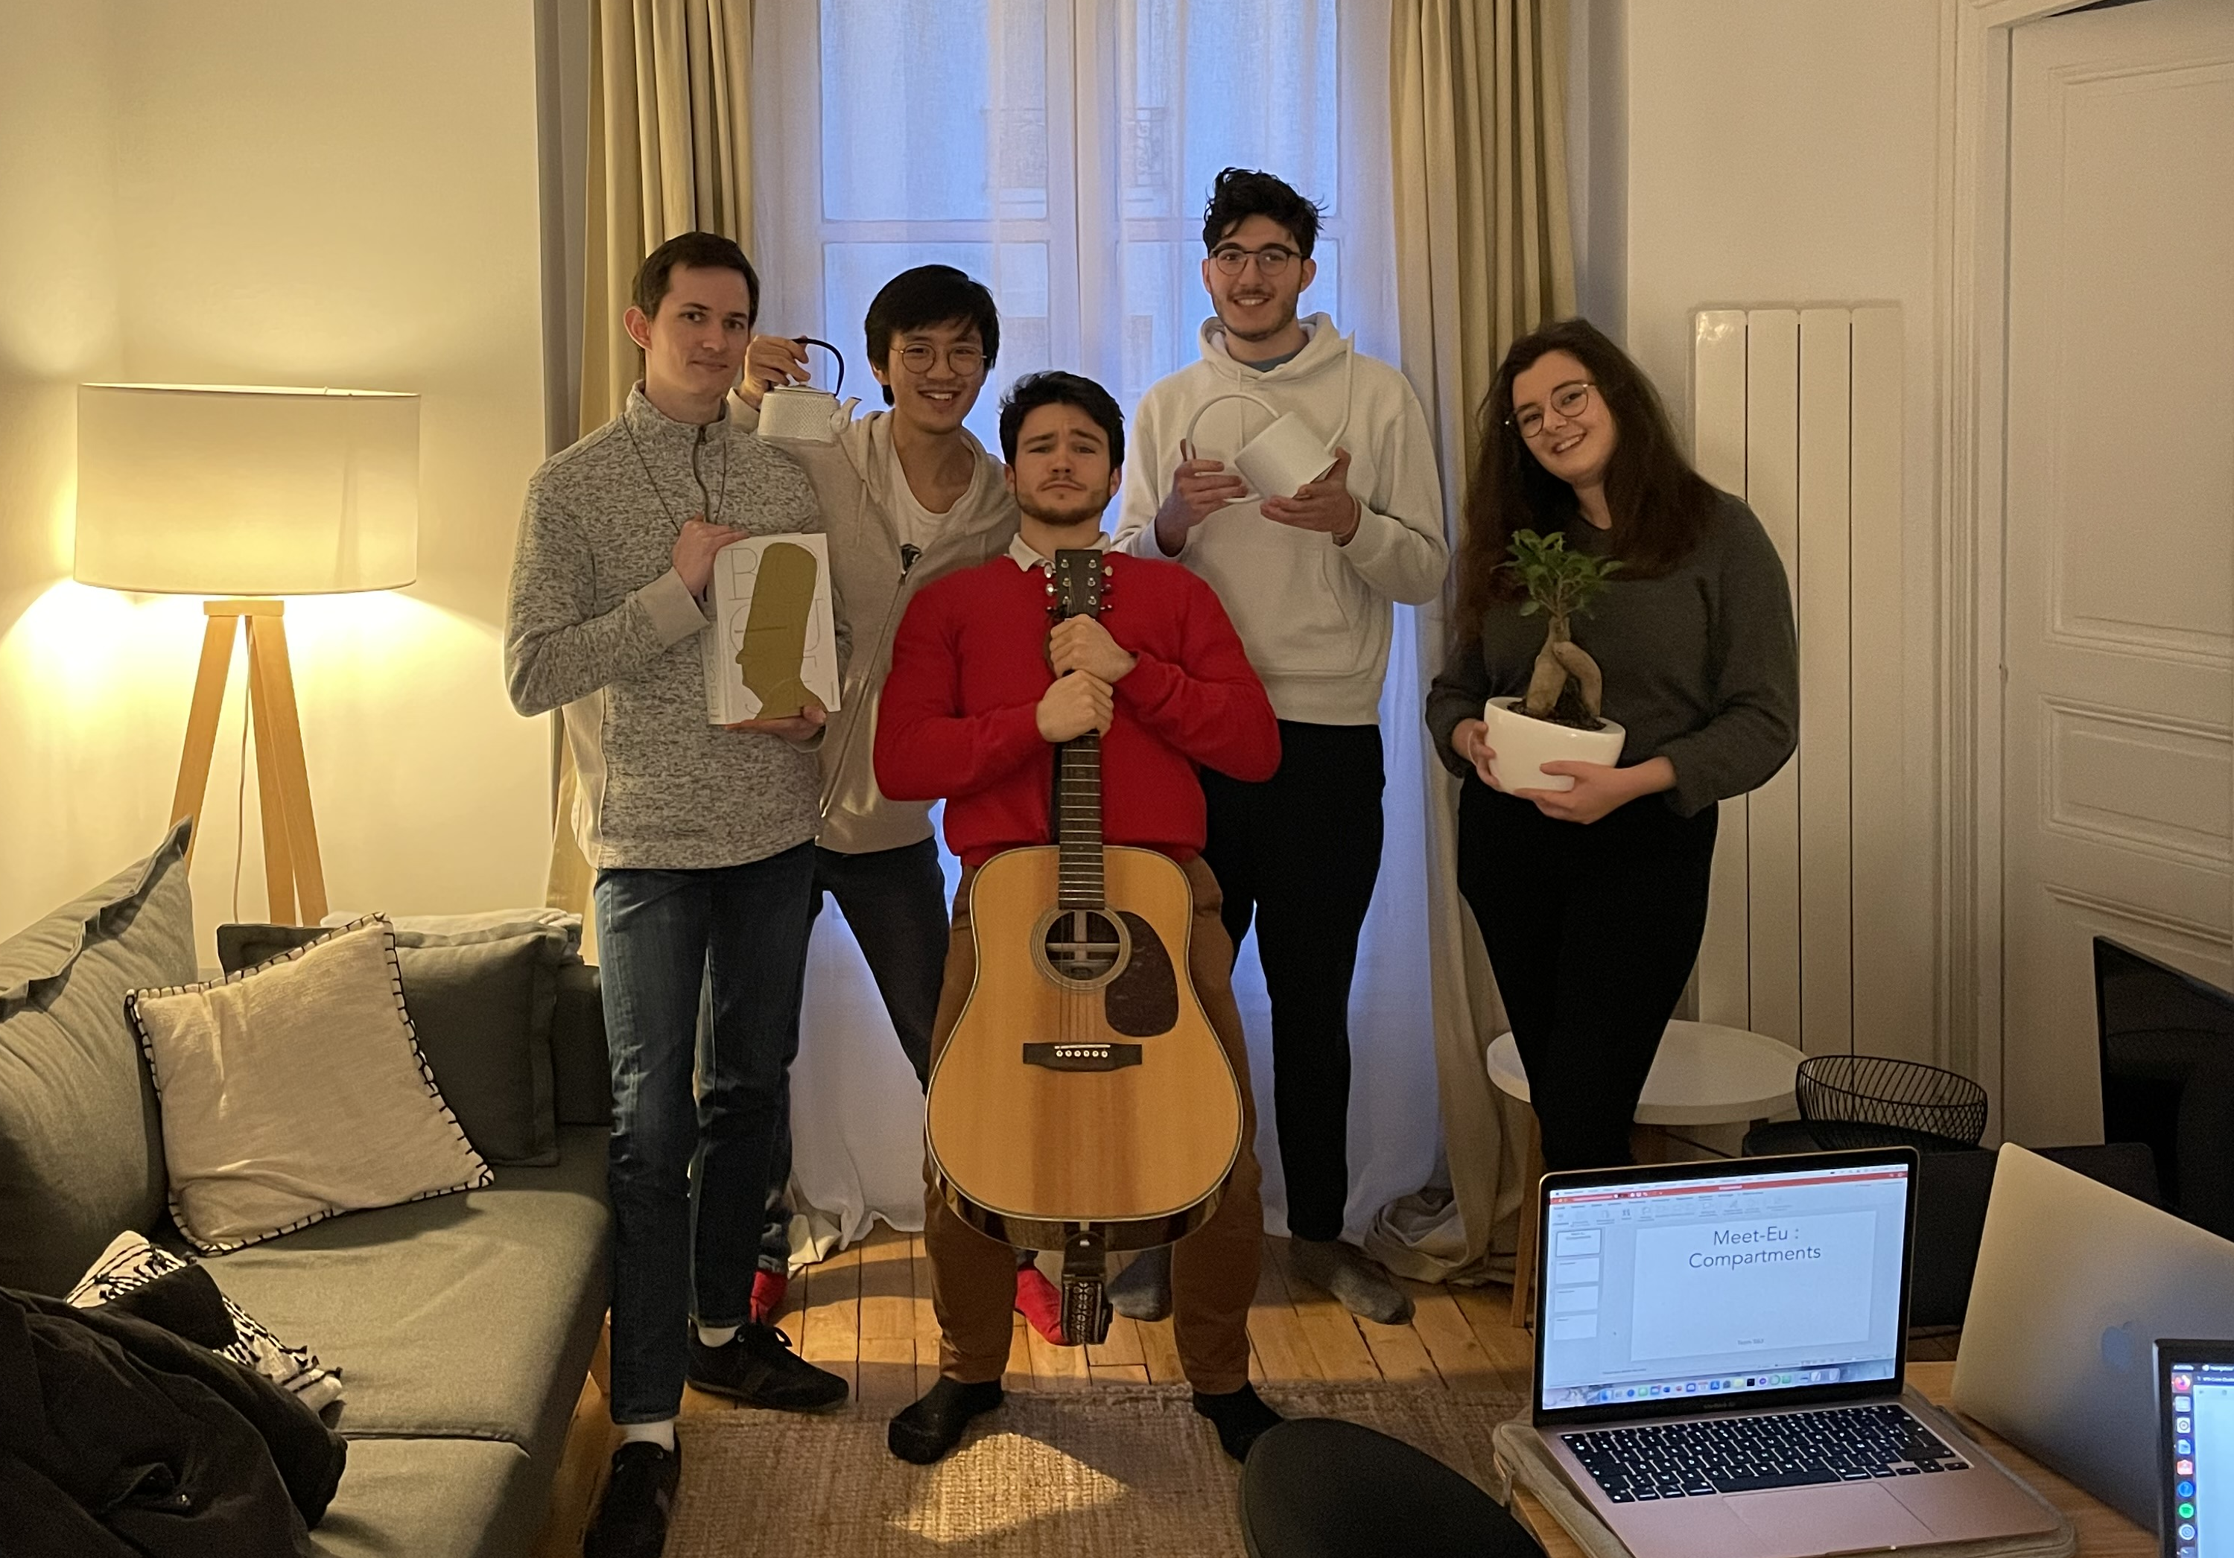
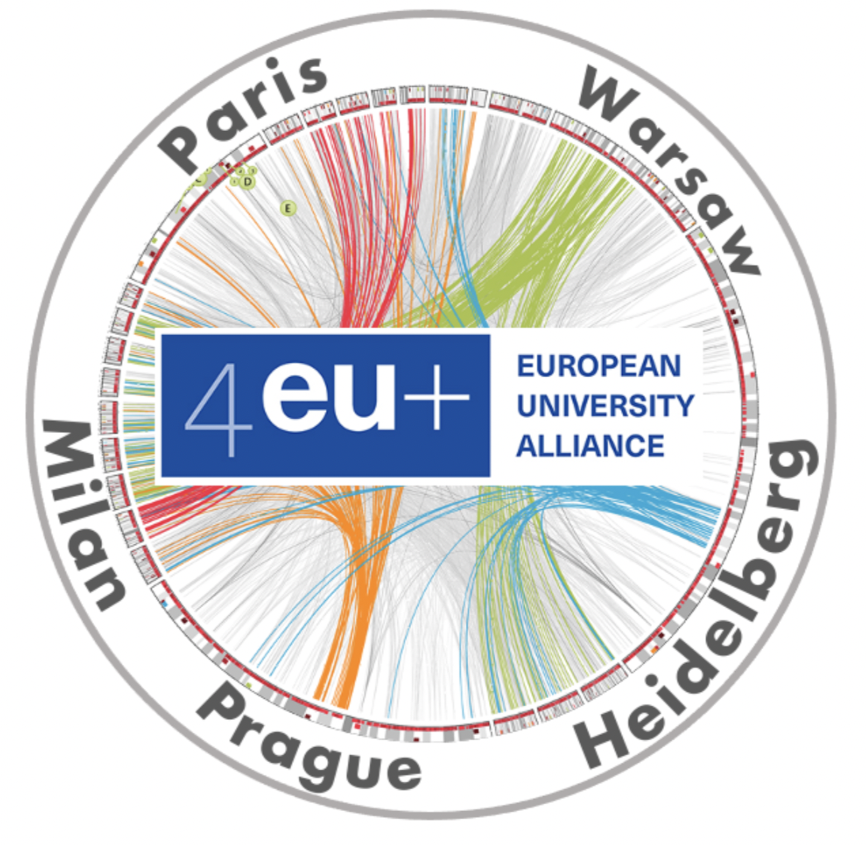
Meet-Eu : Compartments
Julien Kot
Adrien Pauron
Valentin Gherdol
Jeanne Bauduin
Corentin Delhay
Team SB3

Slide 2
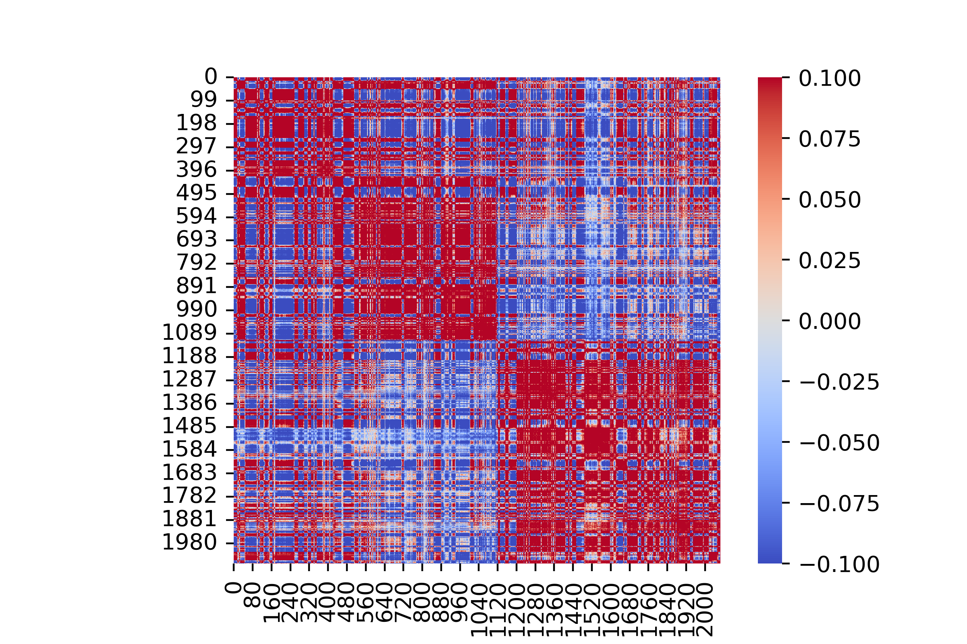
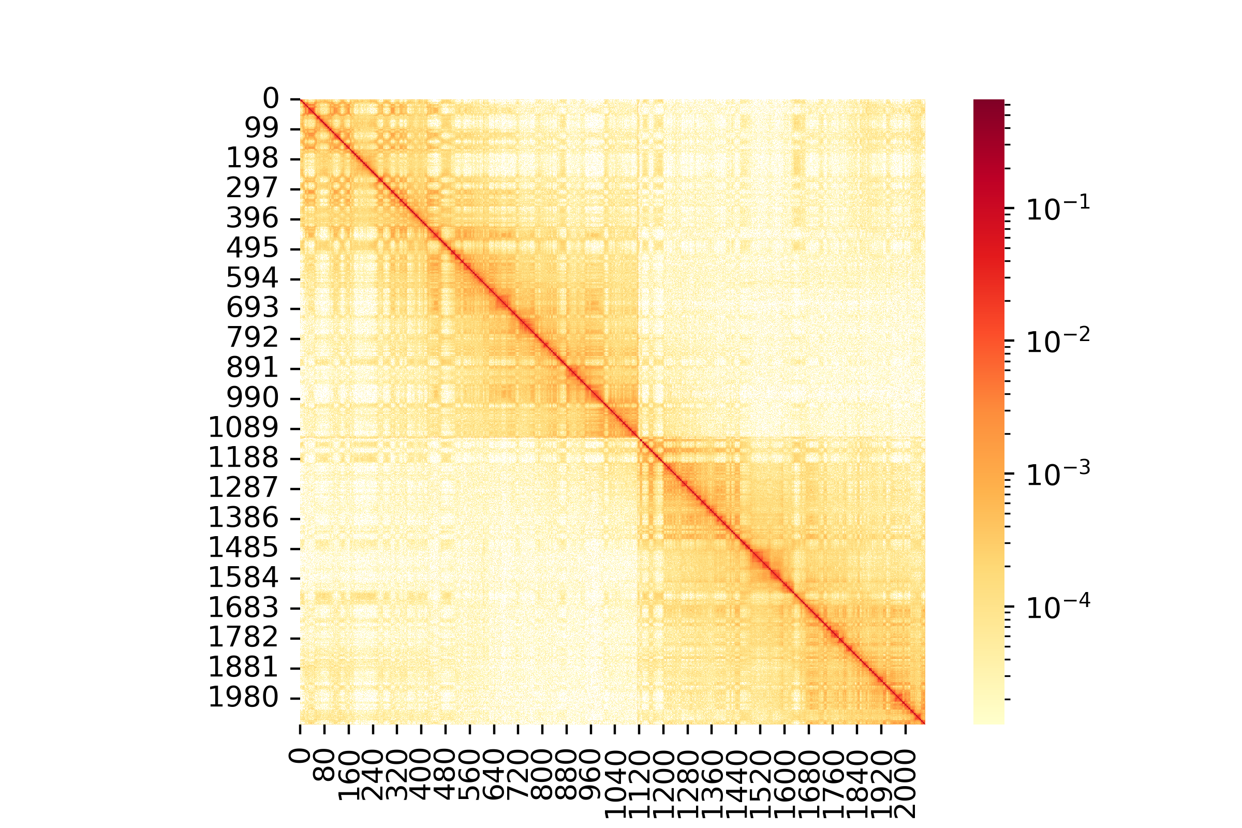
Context and goals
How is chromatin organised in cell?
Hi-C
Determination of an active and an inactive compartment
And maybe more?
Normalization steps
(Iterative SCN, Observed vs expected)
Pearson’s correlation
1

Slide 3
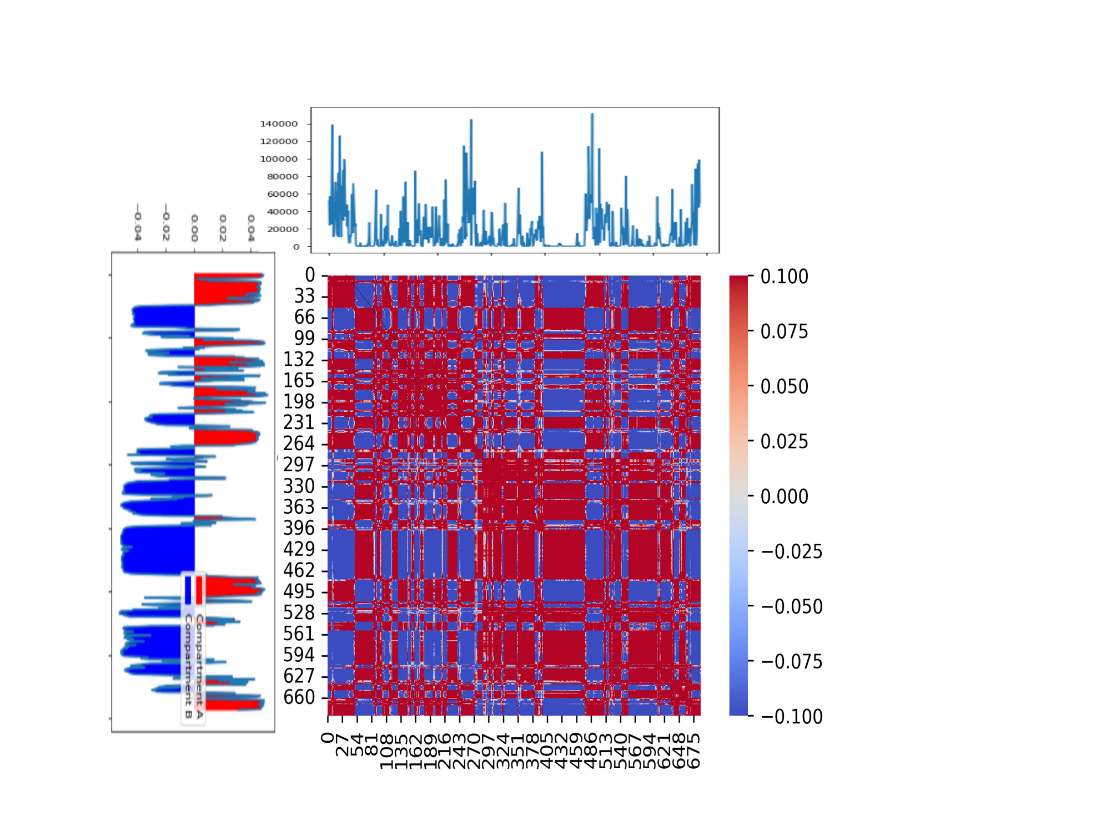
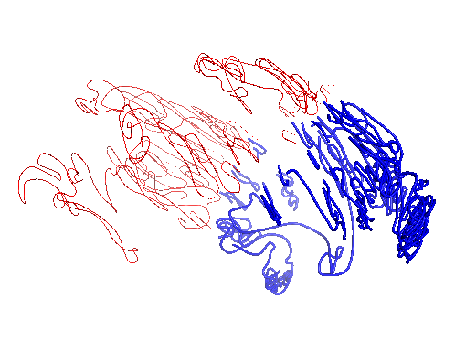
Preliminary results
Gene density
Compartment A (active)
First eigenvector value
Compartment B (inactive)
Chromosome 16, cell type GM12878, resolution 100kb
2

Slide 4

What’s next?
Collaboration with another european team to gather our results and work together towards a better understanding of the subject.
Validation and improvement of our methods and results
Determination of a research axis
What we envision for the future of this project :
Comparison of intra and interchromosomic bounds (What impact does this choice have on the compartments we find?)
What is the impact of the resolution on the compartments we find?
How do these two questions answer to each other?
3
https://github.com/meet-eu-21/Team-SB3

